Slide 1
PROGRAMMING LEARNING PLATFORM FOR KIDS
Course ID : CSE 326
Course Title : Information System Design Sessional
Presentation Topic : Class Diagram + ER Diagram
Group members:
1805095
1805096
1805098
1805103
1805105
1805119
Presented by:
1805096
1805105

Slide 2
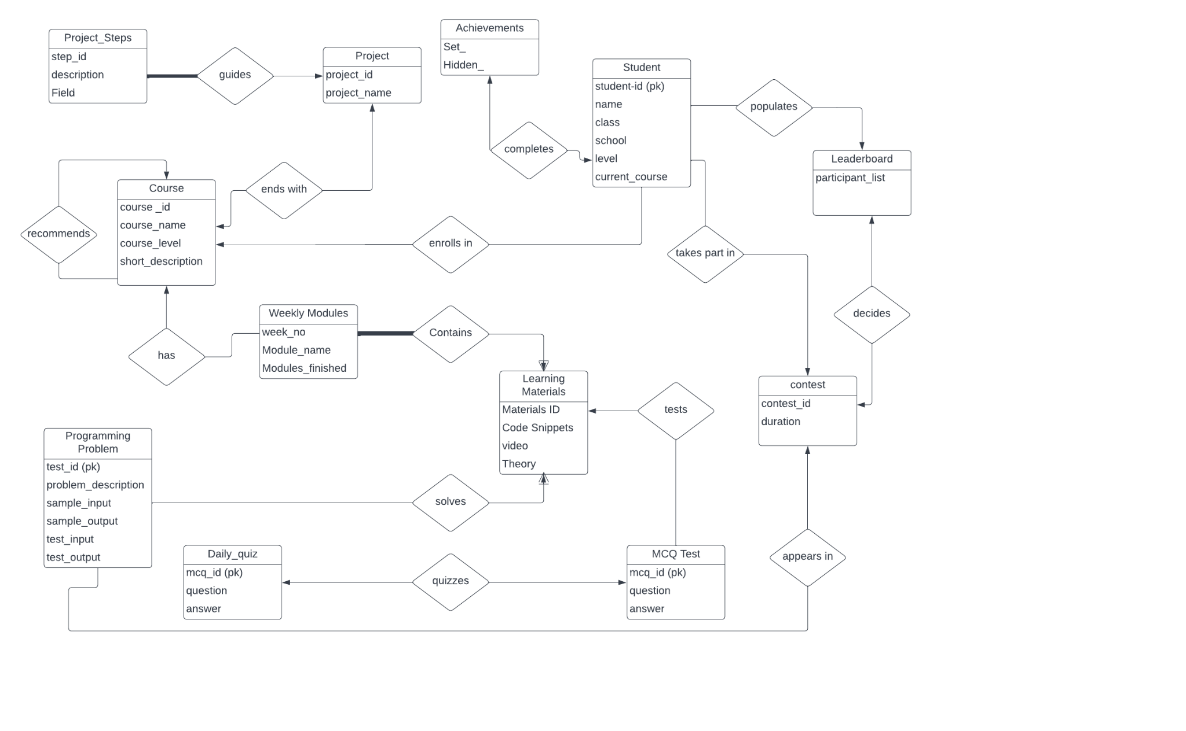
ER Diagram
Notes:
link

Slide 3
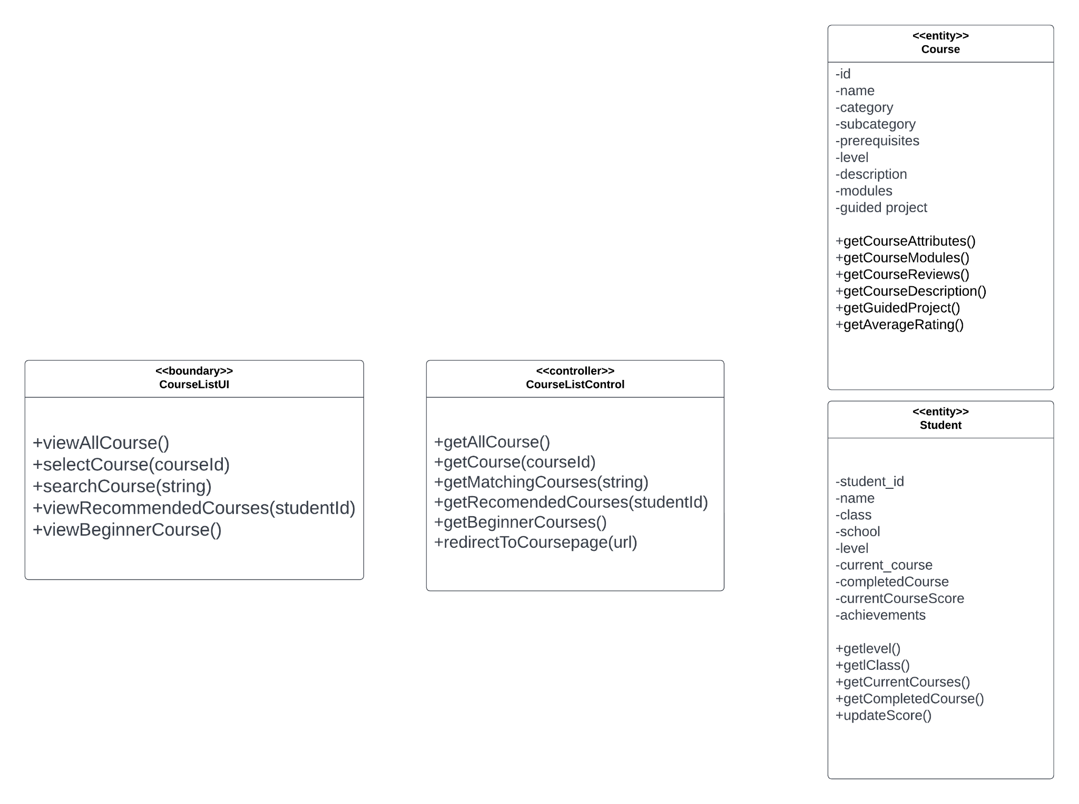
Course List
Notes:
link

Slide 4
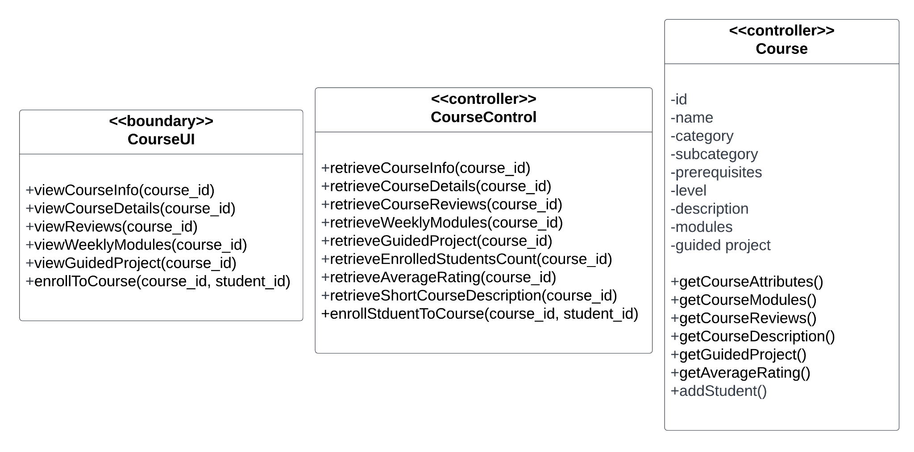
Course Details Page
Notes:
link

Slide 5
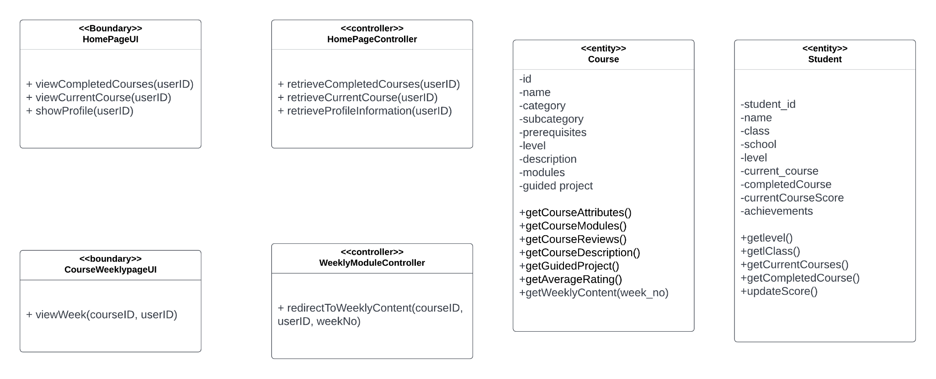
User Dashboard
Notes:
link

Slide 6
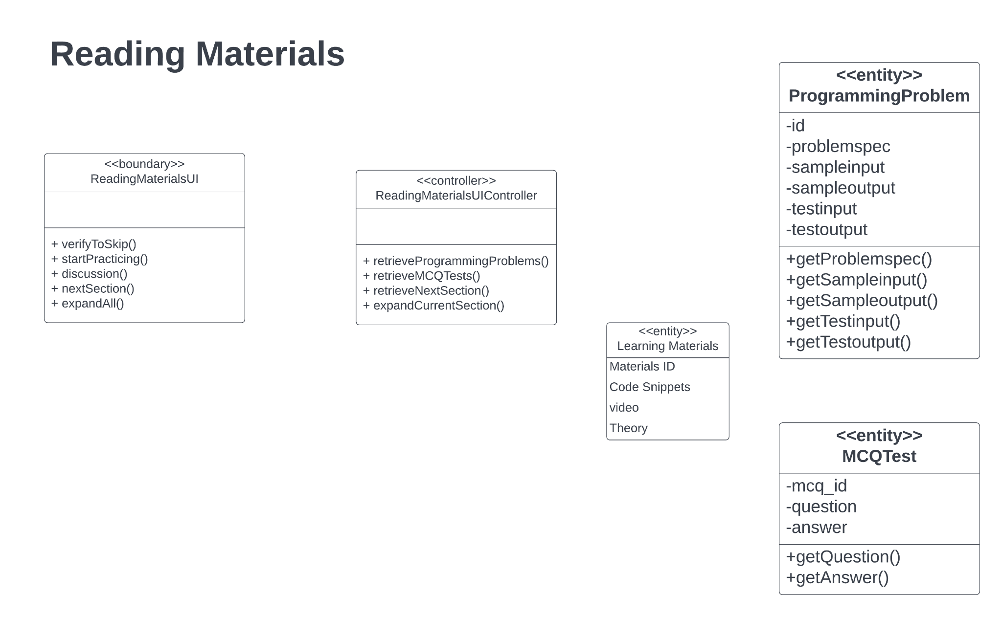
Reading Materials
Notes:
link

Slide 7
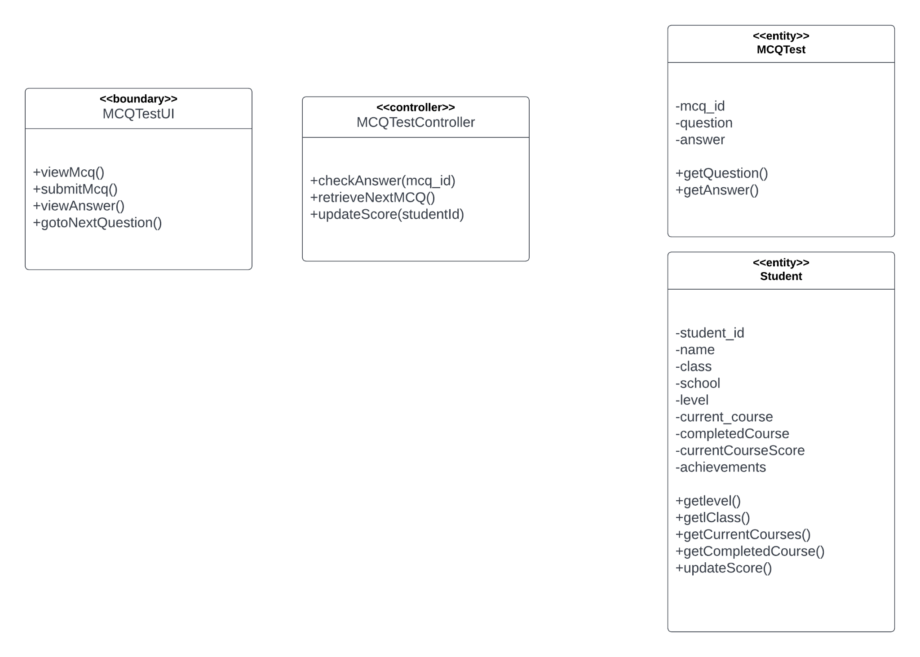
MCQ Test
Notes:
link

Slide 8
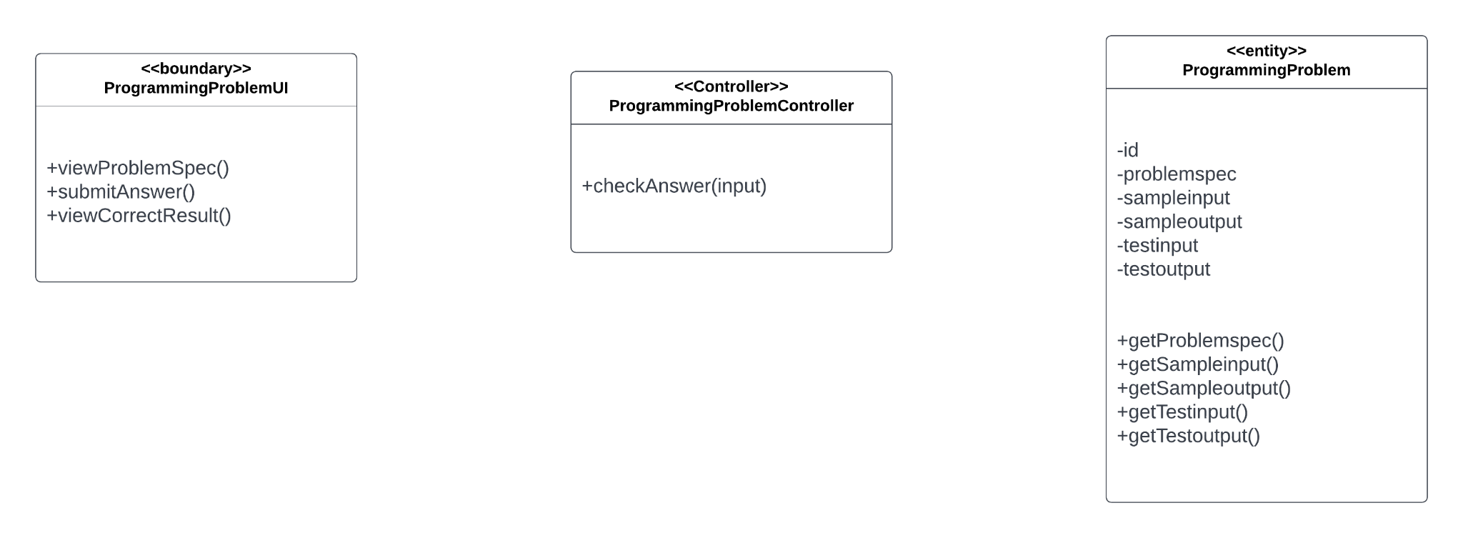
Programming Test
Notes:
link

Slide 9
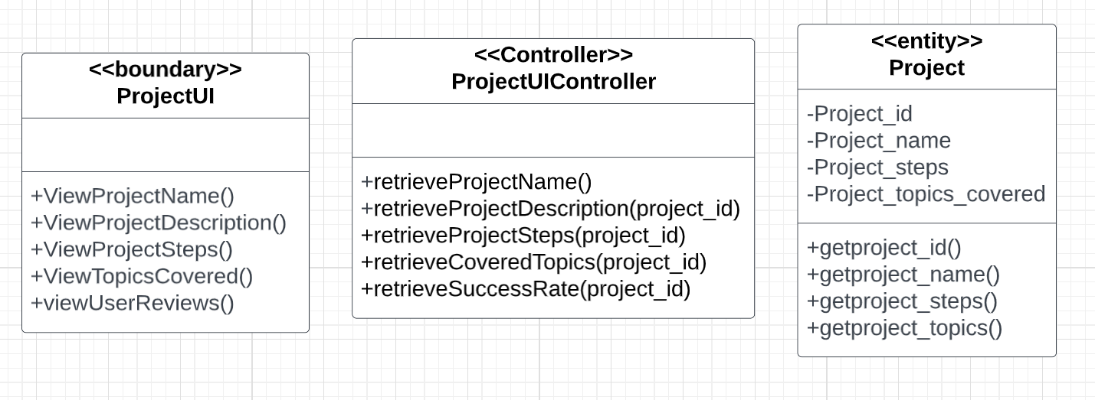
Project
Notes:
link

Slide 10
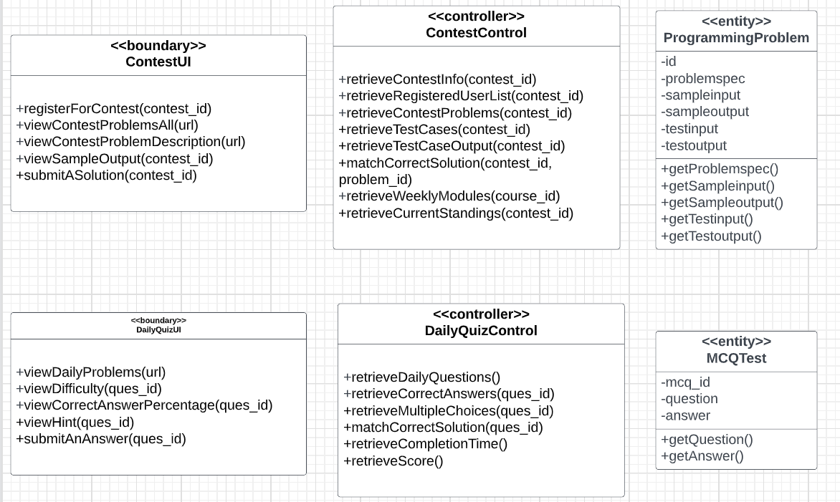
Contest and Daily Quiz
Notes:
link

